Slide 1


In-Class Quizzes
ASEN 3728 Aircraft Dynamics
UNIVERSITY OF COLORADO BOULDER

Slide 2


Slide 3
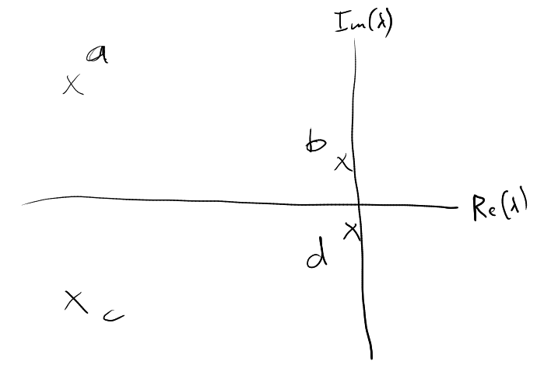

March 5th Quiz
In the image at right, which depicts the longitudinal eigenvalues of a conventional aircraft, which poles correspond to which mode?
A 2x2 matrix has eigenvector [3; 1]. Which of these vectors is also an eigenvector?
The short period mode most prominently involves oscillations in which variable?

Slide 4

Feb 27th Quiz
If the pitch angle is 14 degrees and the angle of attack is 5 degrees, what is the flight path angle?
What is the linearized equation for ?
For an airplane to be statically stable, the center of gravity must be _____ the neutral point.
$Δ\overset{˙}{q}$

